Slide 1
ANIMAL TISSUES
are of two types
SIMPLE
COMPLEX
Further classified into
Made up of more than one type of cells
Further classified into three types
Consists of one type of cells
Epithelial tissue
Connective tissue
Muscular tissue
Nervous tissue
Are of six types
Are of seven types
Bone
Blood
Cartilage
Ligament
Areolar
Tendon
Adipose
1. Simple squamous epithelium
2. Stratified squamous epithelium
3. Columnar epithelium
4. Ciliated columnar epithelium
5. Cuboidal epithelium
6. Glandular epithelium

Slide 2
Simple tissue :
Consists of one type of cells
It is further classified as epithelial tissues
Let us see what are epithelial tissues

Slide 3
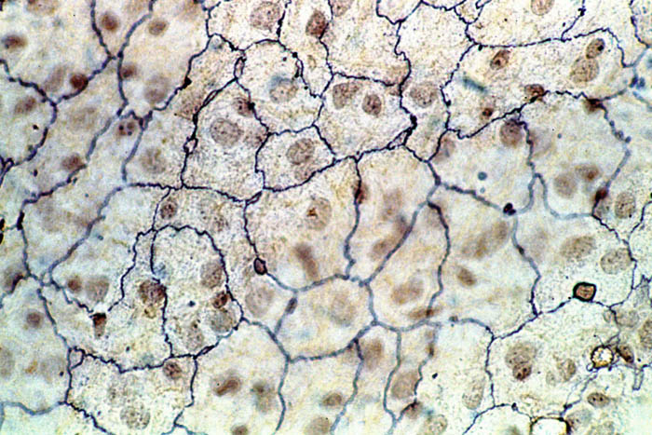
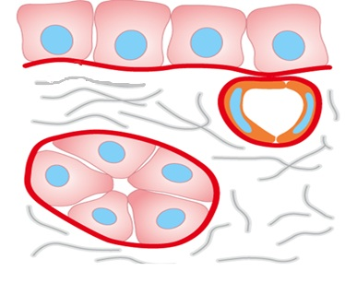
EPITHELIAL TISSUE
Cells of the epithelial tissue are tightly packed and form a continuous sheet.
They have no intercellular spaces.
It is separated from the underlying tissue by an extra cellular basement membrane.
The membrane which separates the epithelial tissue from other tissue
Between the cells
Out side the cells
A layer at the base
Epithelial tissue
Extra cellular fibrous
basement membrane
Connective tissue.

Slide 4
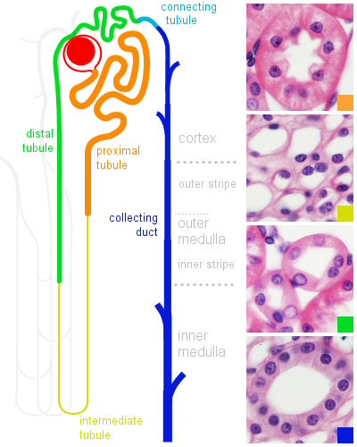
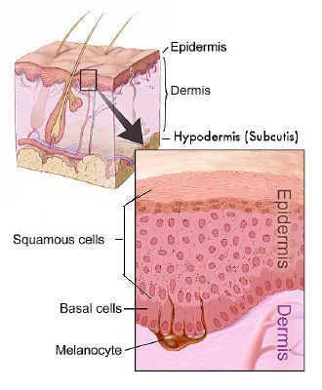
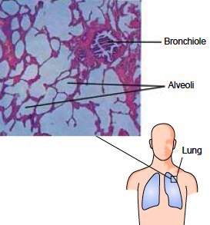
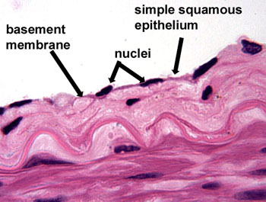
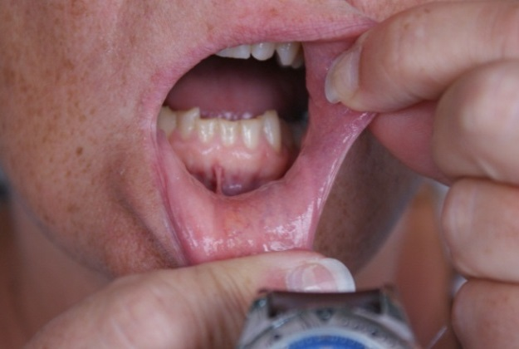
EPITHELIAL TISSUE
Epithelial tissue is present in
Lining of blood
the skin,
lining of the mouth,
vessels,
alveoli of the lungs,
and kidney tubules.
It forms a protective covering of the animal body.
It also acts as a barrier to keep different body systems separate from each other.
Since there are no intercellular spaces, the permeability of the cells play an important role in regulating the exchange of materials between the body and external environment.

